Slide 1
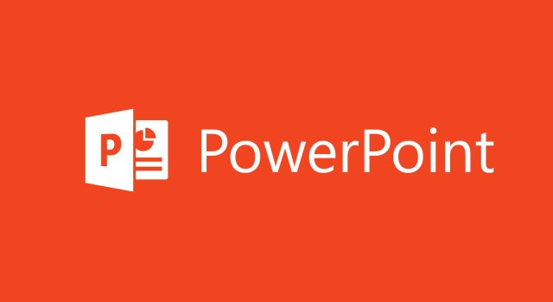
MS POWERPOINT

Slide 2
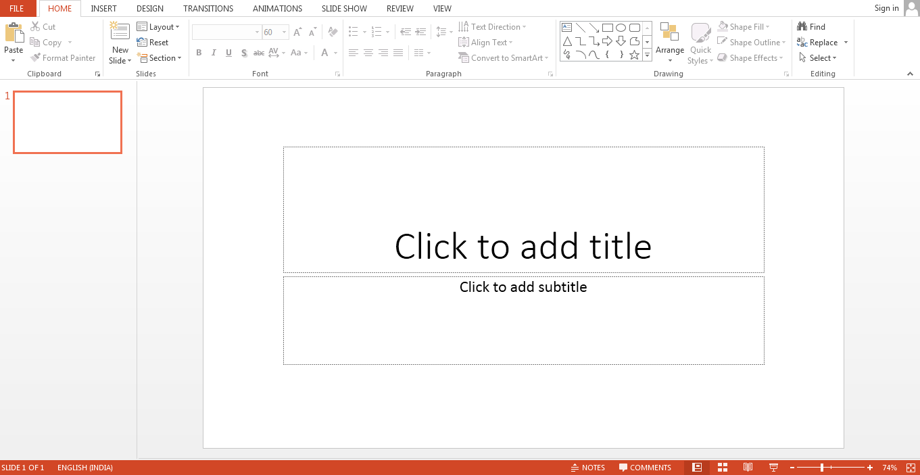
What is MS PowerPoint?
PowerPoint (PPT) is a powerful, easy-to-use presentation graphics software program that allows you to create professional-looking electronic slide shows.
The image given below shows the main page of MS PowerPoint, where a person lands when the program is opened on a computer system:

Slide 3
Features of MS PowerPoint
There are multiple features that are available in MS PowerPoint which can customize and optimize a presentation. The same have been discussed below.
Slide Layout
Multiple options and layouts are available based on which a presentation can be created. This option is available under the “Home” section and one can select from the multiple layout options provided.
Insert – Clipart, Video, Audio, etc.
Under the “Insert” category, multiple options are available where one can choose what feature they want to insert in their presentation. This may include images, audio, video, header, footer, symbols, shapes, etc.
Animations
During the slide show, the slides appear on the screen one after the other. In case, one wants to add some animations to the way in which a slide presents itself, they can refer to the “Animations” category.

Slide 4
Uses of PowerPoint Presentation
PowerPoint presentations are useful for both personal and professional usage. Given below are a few of the major fields where PPT is extremely useful:
Education – With e-learning and smart classes being chosen as a common mode of education today, PowerPoint presentations can help in making education more interactive and attract students towards the modified version of studying
Marketing – In the field of marketing, PowerPoint presentations can be extremely important. Using graphs and charts, numbers can be shown more evidently and clearly which may be ignored by the viewer if being read
Business – To invite investors or to show the increase or decrease in profits, MS PowerPoint can be used
Creating Resumes – Digital resumes can be formed using MS PowerPoint. Different patterns, photograph, etc. can be added to the resume
Depicting Growth – Since both graphics and text can be added in a presentation, depicting the growth of a company, business, student’s marks, etc. is easier using PPT

Slide 5


